Slide 1
CSCI 4401/5401: Principles of Operation Systems
James Wagner
University of New Orleans
Week 1, Lecture 1
August 15th, 2023

Slide 2
What We’re Doing Today
Admin & Syllabus
Introduction to Operating Systems
Overview of topics for the semester
History of Operating Systems
Discuss Assignment 1

Slide 3
Admin & Syllabus

Slide 4
Meeting
Lectures: Tu/Th 6:30pm – 7:45pm
Math 320 or Zoom link on Canvas
Lectures will be recorded and links will be posted on Moodle
Note: Student Hours will not be recorded.
You are required to either attend the live session or watch the recorded video within 24 hrs.
Notes:
Candidate keys AB CB BD

Slide 5
Meeting & Attendance
Lectures: Tu/Th 6:30pm – 7:45pm
Math 320 or Zoom (link is on Canvas)
Lectures will be recorded and links will be posted on Canvas
Note: Student Hours will not be recorded.
In-person students are required to attend lecture in Math 320
Online students are required to either attend the live session or watch the recorded video within 24 hrs.
28 lectures total (not including the midterm). 25 lectures will count toward the attendance grade.

Slide 6
Contact
Course Website (Canvas)
Do use Canvas discussion forums.
Student/Office Hours
M/W/F: 10:00am – 12:00pm
Zoom or 329-B
Email:
jwagner4@uno.edu
Please begin subject line with “CSCI 4401” or “CSCI 5401”

Slide 7
Grading
10% - Attendance (25/28 lectures excluding the midterm)
12% - Six “take-home” quizzes
32% - Four assignments
Mostly programming
Late penalties: 1 day – 10%, 2 days – 20%, 3 days – 30%, > 3 days not accepted
46% - Exams
Midterm (~Week 7 – 8)
Final
CSCI 5401 students will have additional questions on assignments and exams.

Slide 8
Academic Integrity
Read UNO’s Academic Integrity Policy
Chegg.com (and other pay-for-solution websites) are not allowed!
Their “experts” often post incorrect solutions and interfere with the course goals.
Zero tolerance – submitting a solution from one of these websites will result in a 0, and I will file an academic dishonesty report without discussion.

Slide 9
Expectations
Attend all lectures. The examples we go over in class will be helpful for the assignment & exams.
Expect 6 – 9 hours/week of work for a 4000/5000-level course.
While I try to be helpful in office hours and emails, do not expect me to debug or inspect your code for a 4000/5000-level course.

Slide 10
Course Material
Prereq’s
CSCI 2125: Data Structures
CSCI 2467: Systems Programming Concepts
Textbook
Modern Operating System (4th Edition) By Tanenbaum et al. ISBN 978-0133591620

Slide 11
Accommodations
If you have a disability that may affect class participation:
Please reach out to me
Make sure you have communicated with the Office of Disability Services

Slide 12
COVID-19
In general, it is better to reach out to me sooner than later for matters regarding class participation.
If you have a COVID-19 illness, complete the Campus Reporting Form
https://uno.guardianconduct.com/incident-reporting

Slide 13
Class Behavior
You are expected to act professionally both in the classroom and in office hours. Some examples include:
Put all electronics away during class unless they contribute to your lecture engagement.
Do not take phone calls during class.
Do not take phone calls or text while you are in office hours.
If you have a specific question about your assignment, do not come up to me or message me during the middle of the lecture. Save it for before/after class, an email, or office hours.
If you have a specific question that is unrelated to the lecture topic, do not interrupt the lecture. Save it for before/after class, an email, or office hours.
If you miss a lecture, do not ask me what you missed. It is your responsibility to either watch the lecture and/or get notes from another student.
If you show up late to class, do not ask me to repeat what we already talked about.

Slide 14
Questions?

Slide 15
What is an Operating System?

Slide 16
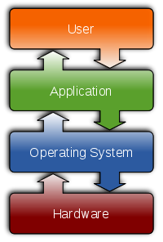


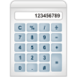

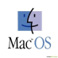


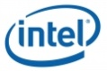

What Operating Systems Do
A computer can be divided into 4 components:
Hardware – computing resources, e.g., CPU, memory, I/O devices
Operating system – a software intermediary between user applications and hardware.
Application programs – used to solve a user’s computing problem, e.g., word processors, spreadsheets, web browsers
Users

Slide 17
What Does an OS Look Like?
Typical User View
Typical System View
Make using a computer easy for a user.
Uses a monitor, mouse, keyboard, etc.
No awareness of resource utilization
How hardware & software resources are shared.
Resource allocator
Manages CPU time, memory space, file storage space, I/O devices, etc.
Decides which programs and users get which resources.

Slide 18
If an OS is software, how is it different than user applications?
Kernel Mode
User Mode
Complete and unrestricted access to underlying hardware.
Can execute any CPU instruction and reference any memory address.
Crashes are catastrophic.
The OS code running at all times is usually called the kernel
Cannot directly access hardware or reference memory.
Must be allocated access to hardware or memory by system APIs.
Crashes are recoverable.

Slide 19
Purpose of an OS
Provide resource abstractions for applications
Manage and allocate resources

Slide 20
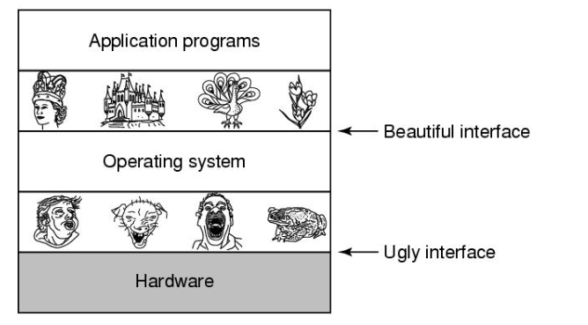
Purpose #1: Resource Abstraction
How does an OS abstract file creation, reads, and writes?
An application does not need to know how a device works to read/write a file.

Slide 21
Purpose #2: Resource Manager
What would happen if two programs are allowed to print simultaneously?
The OS provides controlled allocation of processors, memory, and I/O devices to programs
Some resources …
Can be shared, e.g., each process gets its own memory allocation
Must take turns, e.g., print jobs

Slide 22
Purpose of an OS (cont’d)
Does an OS know how to control every possible piece of hardware that you might connect to it?
OSes contain many device drivers for controlling devices.
An application that creates a file does not need to worry about spinning disks and the correct read/write head

Slide 23
Why Study Operating Systems?
Would you actually write an operating system?
Highly unlikely!
Why study them?
Large complicated software systems
Draws on lots of areas: software engineering, architecture, data structures, networking, algorithms
Can apply techniques used in operating systems to other areas
“Grungy” things sometimes do require modifications to an OS; you can’t do this if you don’t understand them.

Slide 24
Operating Systems Overview

Slide 25
Bootstrap Program
For a computer to start running, it needs an initial program to run called a bootstrap program.
Started by the BIOS (basic input/output system) – small program separate from the OS installed on the motherboard.
Contains basic procedures, e.g., read the keyboard or write to the screen
Grand Unified Bootloader (GRUB) is the bootstrap program for Linux.
The bootstrap program locates the OS kernel and reads it into memory.
The user can change the boot device/partition just after booting but before the OS kernel is read.
When the OS starts, it initializes any necessary data or processes and starts a login program or GUI.

Slide 26
Interrupts & System Calls
Operating systems are driven by interrupts (i.e., respond to events)
Hardware can send interrupts at any time. Ex. your mouse sends a signal to the CPU
Software can send interrupts through system calls
We will discuss how hardware and software send interrupts.
Note: hardware sends interrupts and software sends traps
Traps are a subset of interrupts

Slide 27
Process Management
A program’s instructions need to be executed by the CPU.
A program in execution is called a process.
We will discuss how the OS:
Creates & deletes processes.
Processes receive necessary resources and process do not interfere with each other.
Suspends and resumes process.
Synchronizes processes and provides communication between process.

Slide 28
Memory Management
The CPU reads instructions & data directly from memory.
For a program to be executed, it must be in memory
We will discuss how the OS manages memory:
Keeps track of what memory is used and by which processes.
Decides which processes and data to move into and out of memory
Allocates and deallocates memory

Slide 29
File System Management
The operating system provides a logical view of storage to users, files.
We will discuss how the OS:
Creates and deletes files/directories
Supports file manipulation (e.g., open)
Maps files onto persistent storage

Slide 30
Mass Storage Management
Memory is too small to fit all of our data. We also need secondary storage.
We will discuss how the OS:
Manages free space on disk
Allocates storage to files
Schedules read/write operations on disk

Slide 31
Other OS Topics
Protection – provide controlled access
Security – guard against unauthorized access
Virtualization
Notes:
Protection (internal) – controlled access, security (external) – guard against unauthorized access

Slide 32
History of OSes

Slide 33
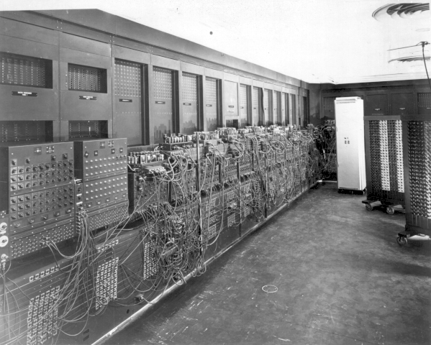
1st Gen (1945 – 55)
Motivated by the demand to compute bomb trajectories for WWII.
ENIAC
Weighed 30 tons
20,000 vacuum tubes (opposed to transistors)
2-day human calculation -> 30 secs
5,000 additions/sec
No programming languages, not even assembly.
No operating system
Programming was done by connecting (1000’s) of cables to plugboards
ENIAC, mid 1940s

Slide 34
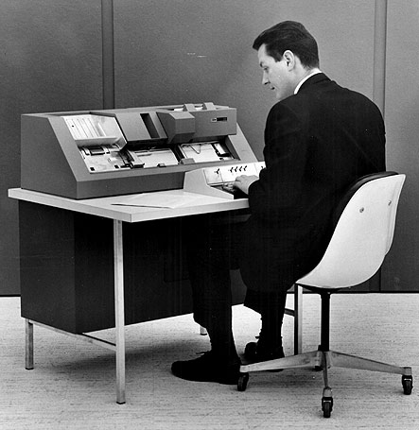
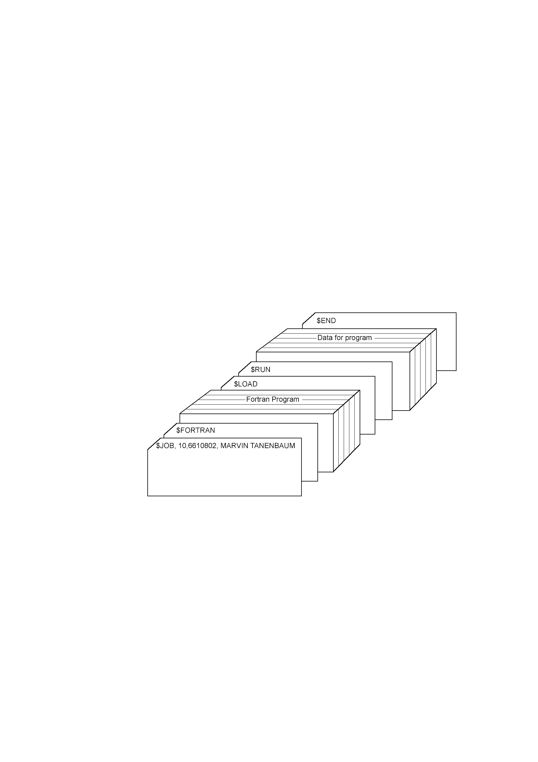
2nd Gen (1955 – 65)
“Mainframes”
Programs could be written on punch cards (rather than wiring plugboards).
Transistors improved reliability over vacuum tubes.
Batch systems were used to save time.
Example FORTRAN job
written on punch cards

Slide 35
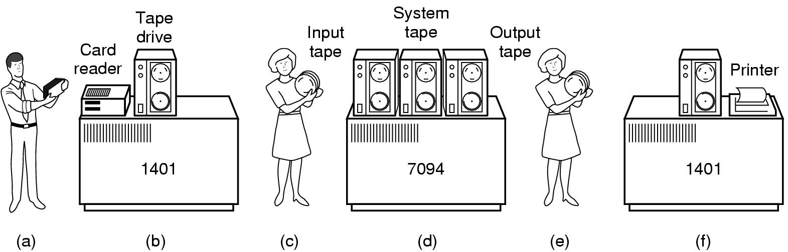
2nd Gen: Batch Systems
1) Walk card decks to a cheap computer which puts a set of jobs on magnetic tape (batches them)
2) Walk tape over to the mainframe with all the processing power.
3) Walk output tape to a cheap computer to print.

Slide 36
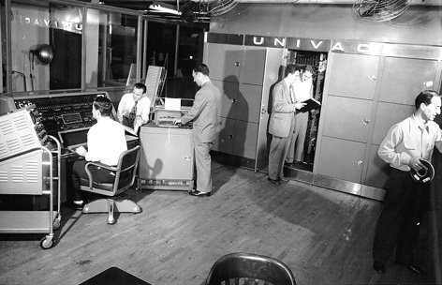
2nd Gen: UNIVAC (early 1950s)
Substantially more reliable than ENIAC
Stored program computer – no more pulling wires.
Walk-in design
5000 tubes
8 tons
Over 40 sold

Slide 37
3rd Gen (1965 – 1980s)
We will see multiprogramming and timesharing.
Two types of computers:
Scientific computers for complex calculations (science & engineering)
Commercial computers for sorting and printing (banks)
Not compatible, but there was a demand for compatibility.
IBM 360
First to use integrated circuits - a series of integrated machines to handle all computations.
Used the first operating system, OS/360
Led to multiprogramming

Slide 38
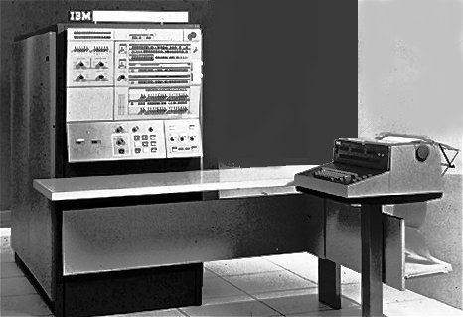
3rd Gen: IBM 360 Series (mid – 1960s)
Very stable
Performed 10M’s of operations/sec
Wildly popular – gave IBM domination over the market
Sold 14K units by 1968

Slide 39
3rd Gen Problems
Scientific calculations required little I/O but needed the CPU.
Commercial applications required lots of I/O.
The CPU would sit idle waiting for tape I/O to finish…
What would you do?

Slide 40
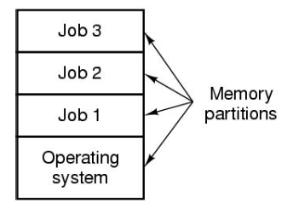
3rd Gen: Multiprogramming
Partition memory into several pieces for each job.
While one job does I/O writes, another uses the CPU.
CPU is efficiently utilized!

Slide 41
3rd Gen: Timesharing
Remember the good old days of the 1st gen computers?
We (programmers) had computer to ourselves
Batch jobs required sharing
How long will it take you to find a simple compilation error?
Led to timesharing:
Similar idea to multiprogramming
Each user gets their own terminal
Timesharing intuition:
You have 20 users
17 of them are thinking or getting coffee
CPU is allocated to the 3 jobs/users that want service

Slide 42
3rd Gen: MULTICS
MULTiplexed Information and Computing Service
Built by MIT, Bell Labs, and GE
Large-scale timesharing (designed for 100s of users)
Not a lot of users, but introduced and influenced many seminal ideas…
Remote terminal use
Highly reliable internet file system
One-user version of MULTICS led to UNIX OS (which did become very popular)
Smaller UNIX clone -> Linux
Timesharing died out during the 90s. What did this idea come back as that we see today?
Hint: personal small computers, data centers, etc.

Slide 43
4th Gen (1980 – today)
Timesharing is a good solution for large, expensive machines
What if you could afford your own computer?
Never wait for:
Available terminals
Long running jobs to finish
System downtime (another user crashed the system)
PC Operating Systems
MS-DOS – Disk Operating System
Incorporated many features from UNIX
GUI – Graphical User Interface
Built on top of an OS
Provides point-and-click access (Apple, Windows)

Slide 44
Assignment 1

Slide 45
Assignment 1
Due Monday, September 4th @ 11:59pm
Using your UNO credentials, log into https://cyber-range.cs.uno.edu/
I cannot add you to the class until you log in.
Do this right away!

Slide 46
Summary/Review
What is the purpose of an OS?
What problem(s) did multiprogramming solve?
What problem(s) did timesharing solve?
What is a modern-day version of timesharing?

Slide 47
Next time
Computer Hardware Review
System calls
Virtual Machines

Slide 48
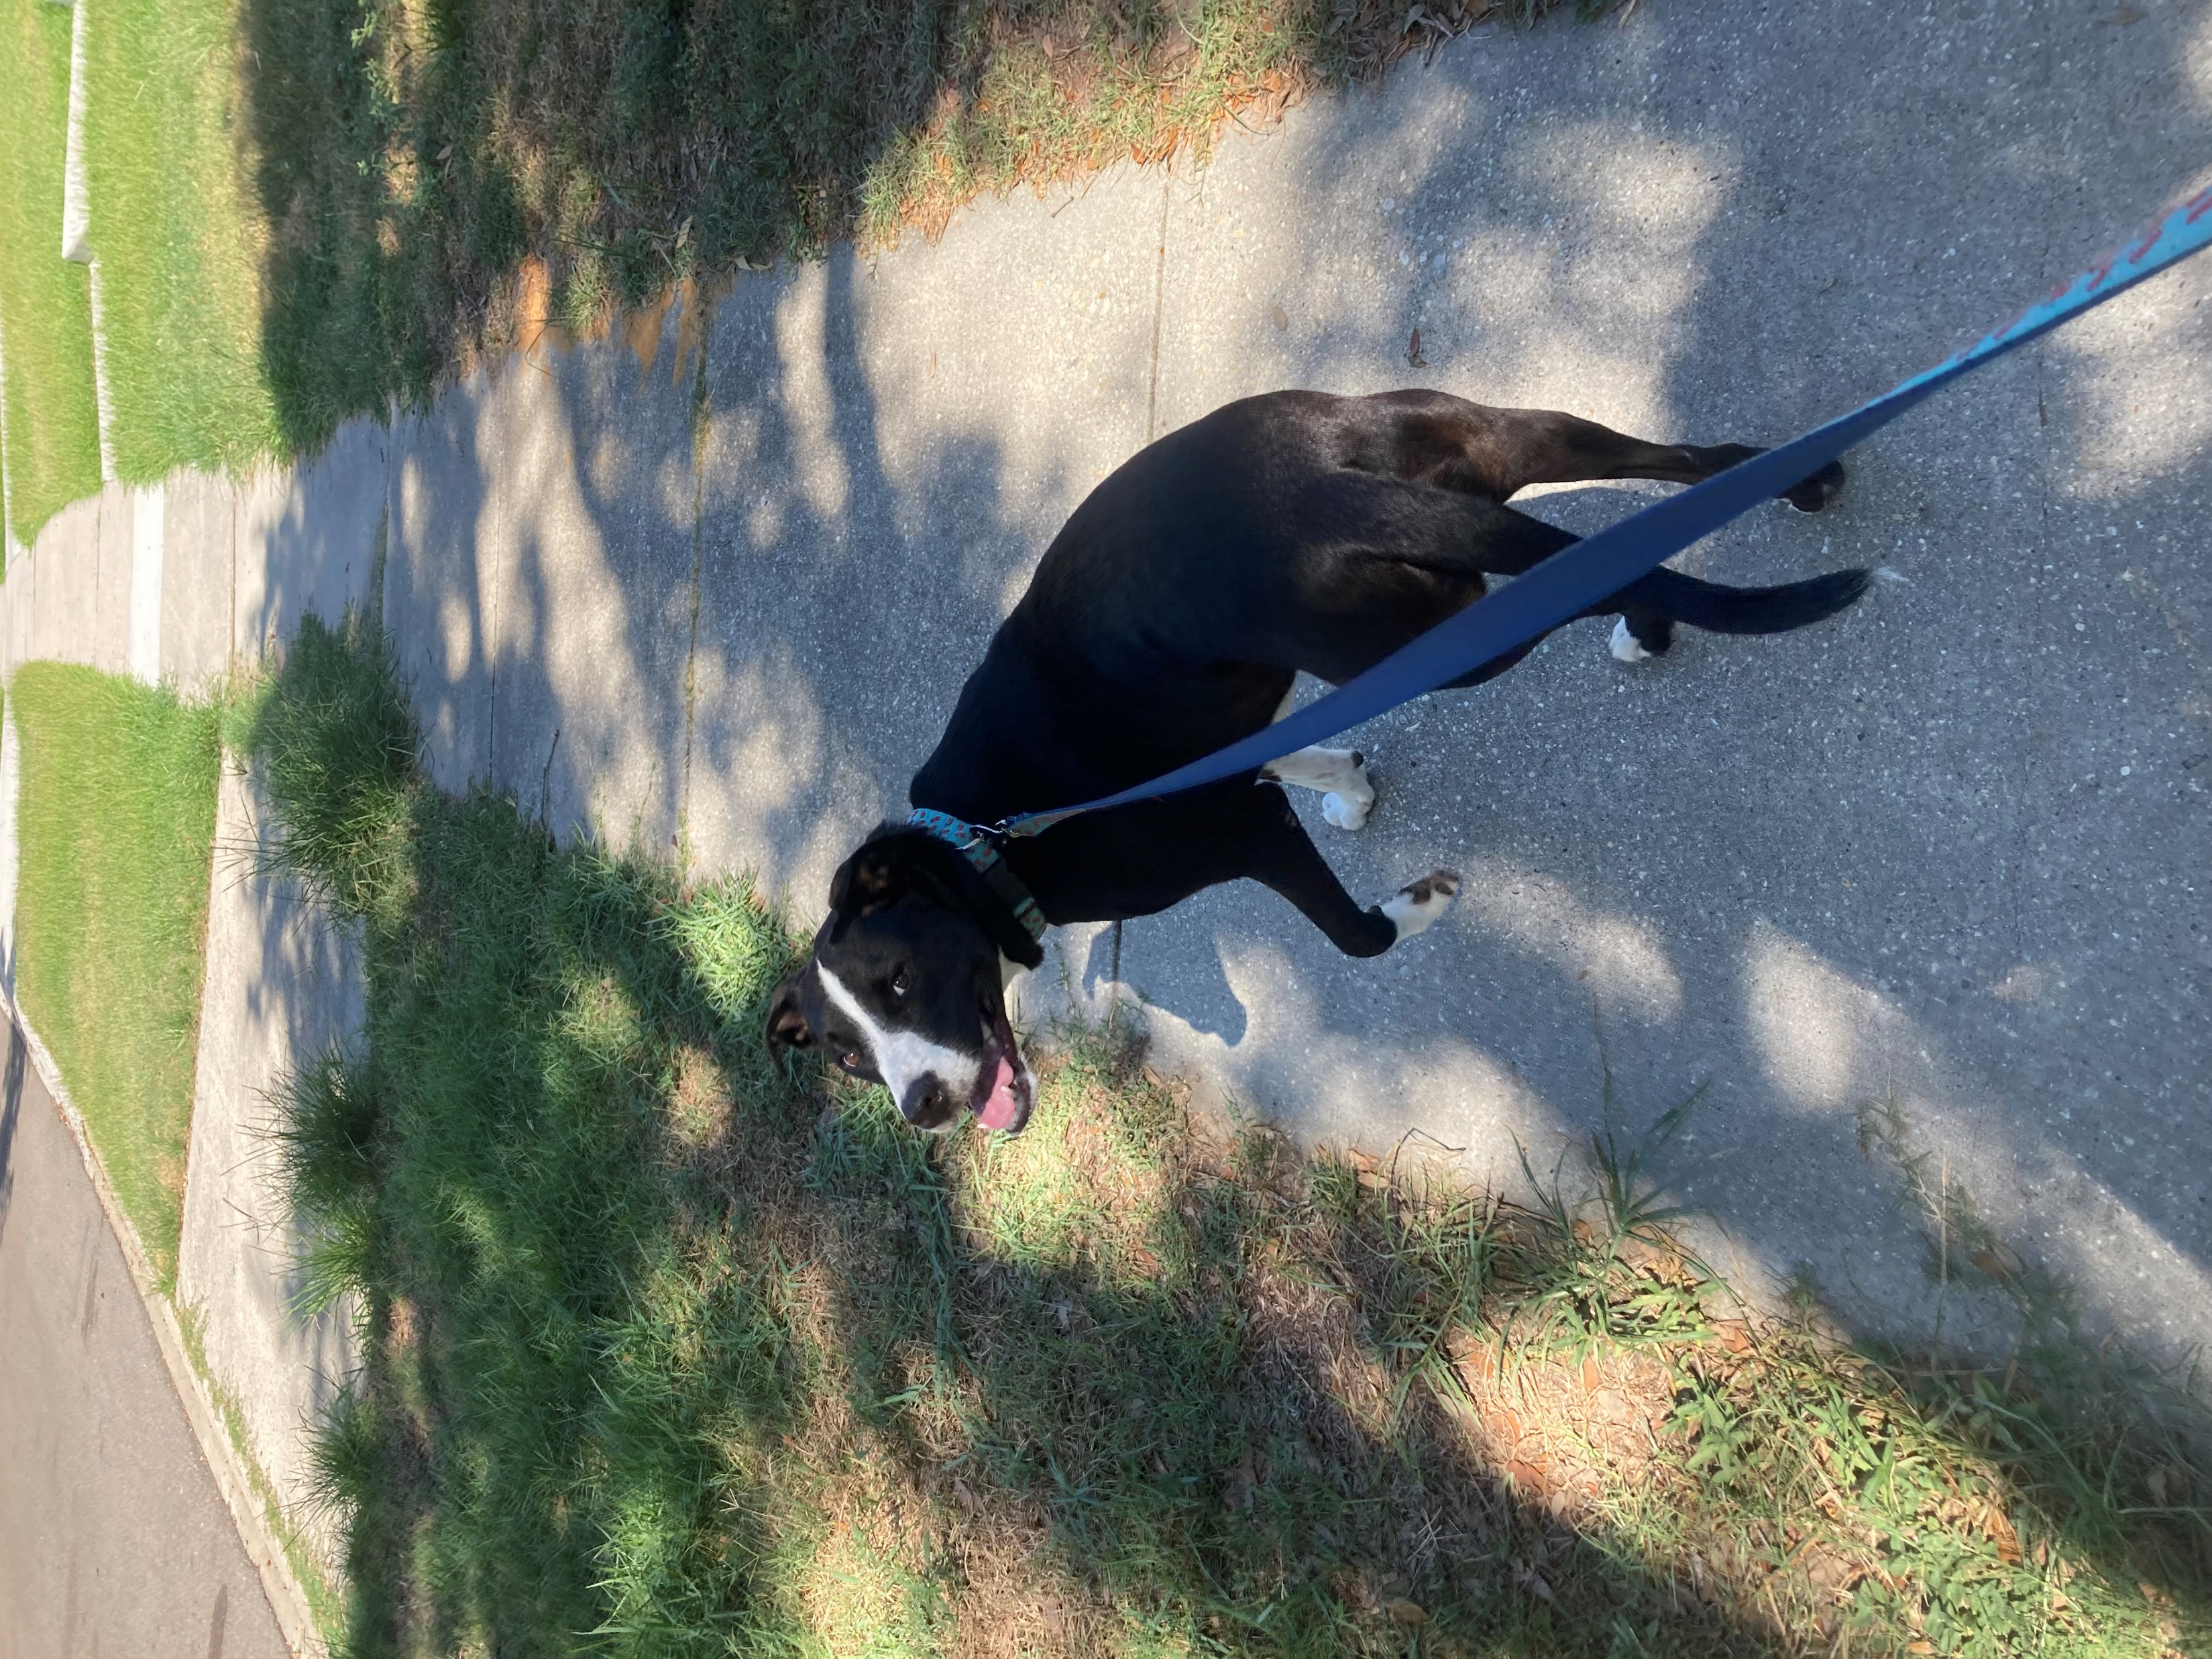
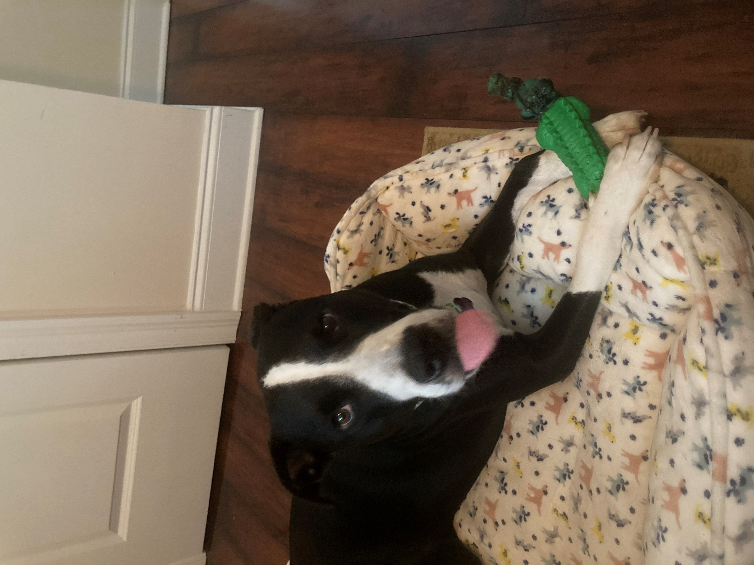
Class Reminders
Log in to cyber range
https://cyber-range.cs.uno.edu/
It’s Wisner’s (aka “Wiz”) birthday today. He’s 3!

Slide 49
Computer Hardware Review

Slide 50
Motivation
An operating system extends a computer’s instruction set and manages resources.
Must know a lot about hardware
We are reviewing hardware to know how the operating system sees it.

Slide 51
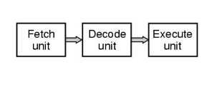
Processors
CPU -> “brain”
Pipelining: fetch instructions and execute them
Fetch instruction₁ from memory
Decode instruction₁
Execute instruction₁
Move to instruction₂

Slide 52
Processors: Registers
CPU registers store variables and temporary results.
Instructions usually say what data to load from memory into a register
Several special registers are made available to programs
Program Counter: memory address of the next instruction
Stack Pointer: points to the top of the current stack in memory.
Process stack: input parameters, local variables, temp variables, variables not typically stored in registers
The OS must be aware of all registers to stop/restart processes
Can be expensive…

Slide 53
Processors: Multithreading
Thread: lightweight process (more in weeks 2 & 3)
Multithreading allows the CPU to hold the state of two threads
Switching back and forth is much faster than stop/restart process
One process at a time is still running but OS sees each thread as a separate CPU.
Example: 2 CPUs each with 2 threads:
OS sees 4 CPUs
Anyone see a trade-off?

Slide 54
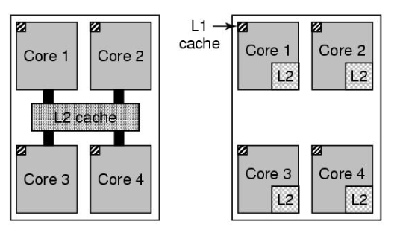
Processors: Multicores
CPU chips have 4, 8, or more complete processors (or cores)
Each core has own independent CPU
Caches can be shared or separate
Shared
L2 cache (e.g., Intel)
Separate
L2 caches
(e.g., AMD)
Quad-core
chips
Trade-offs?

